Slide 1
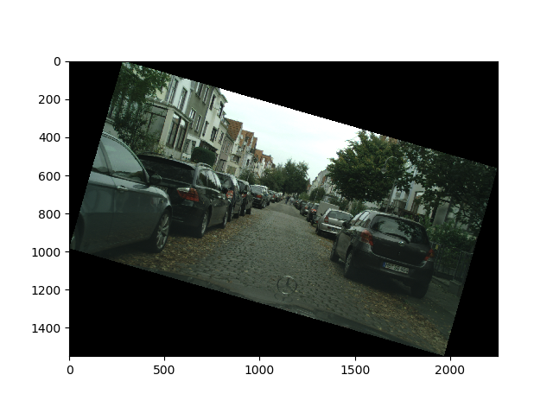
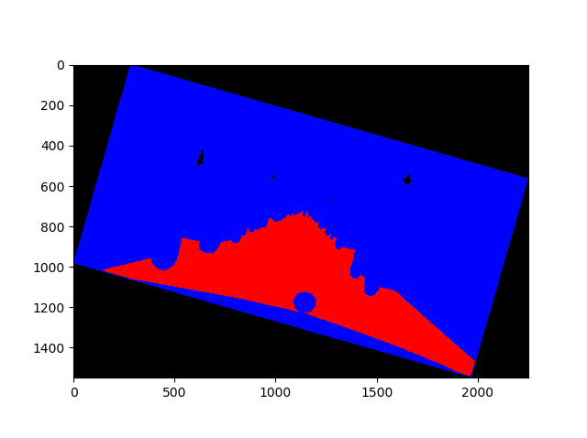
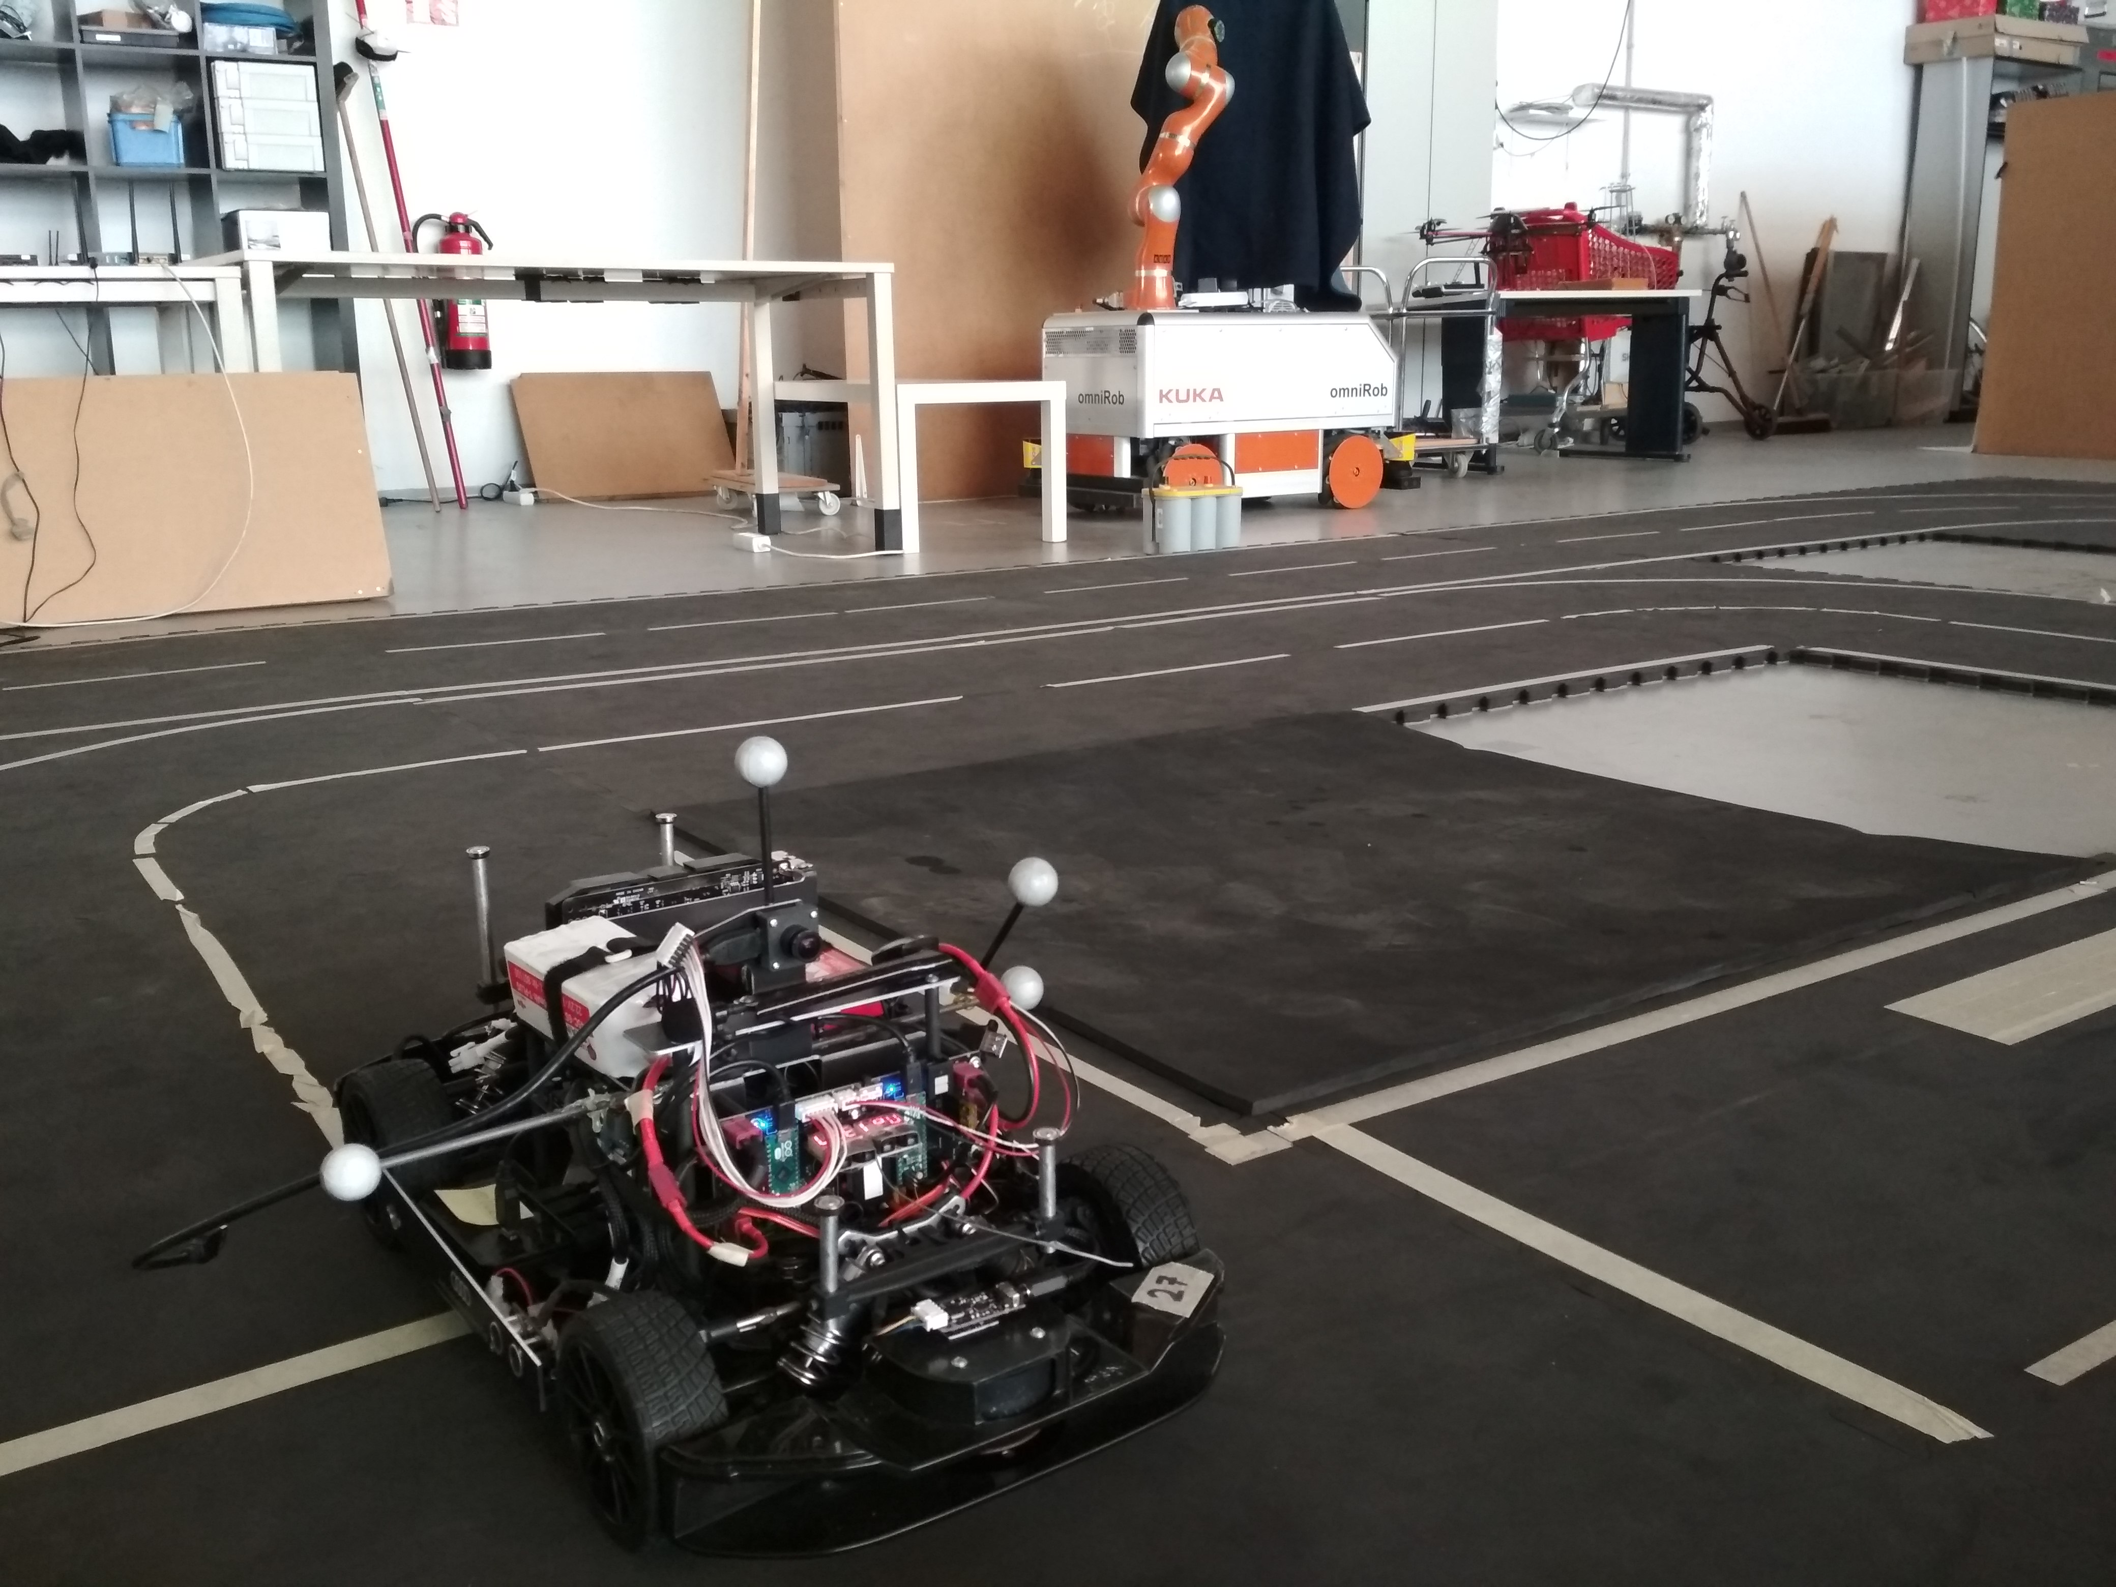
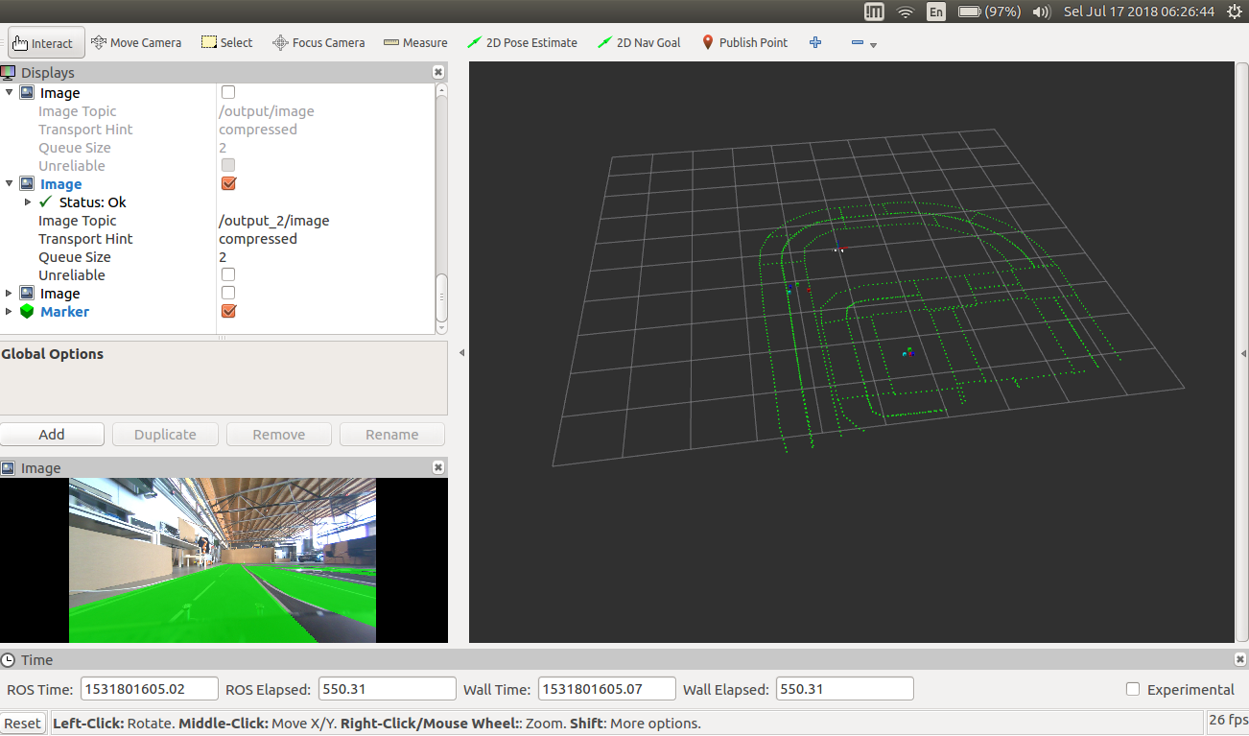
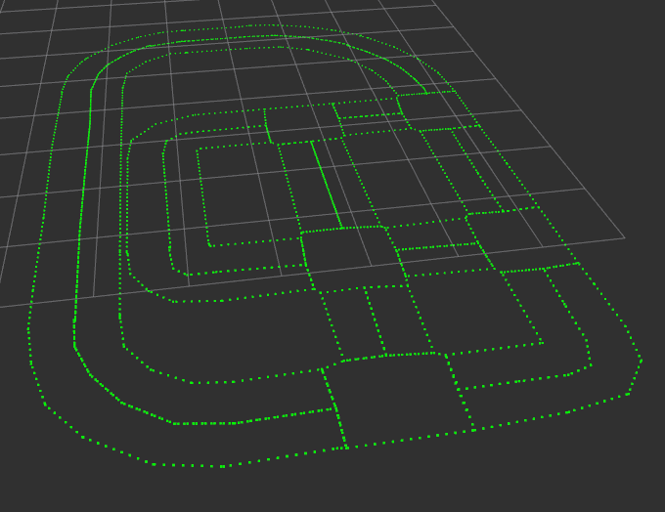
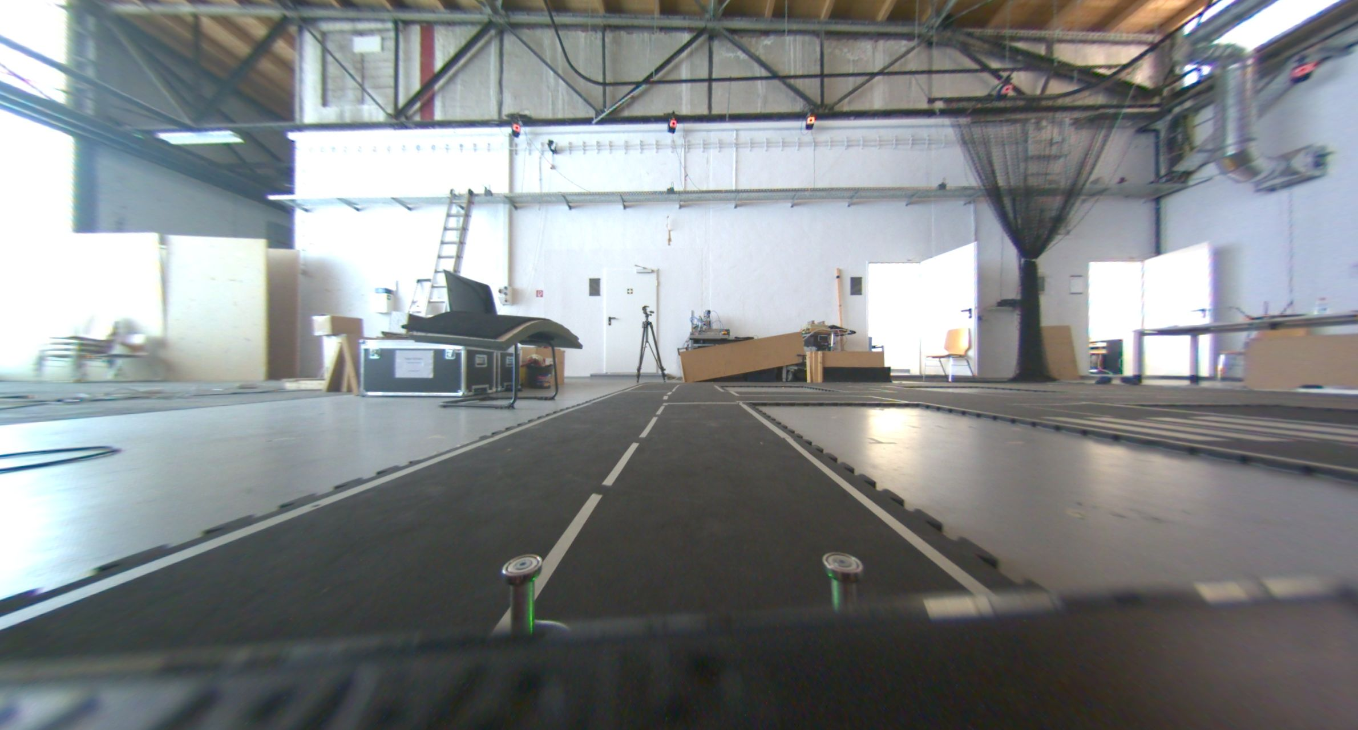
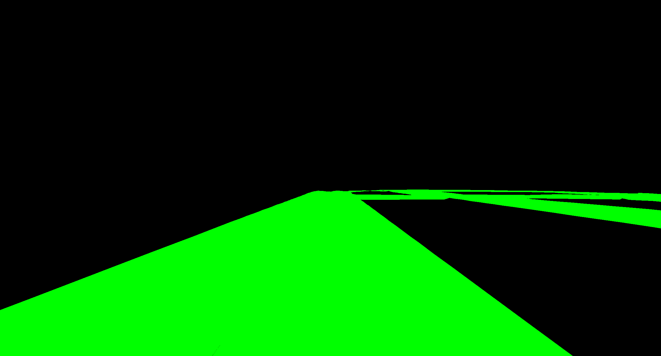
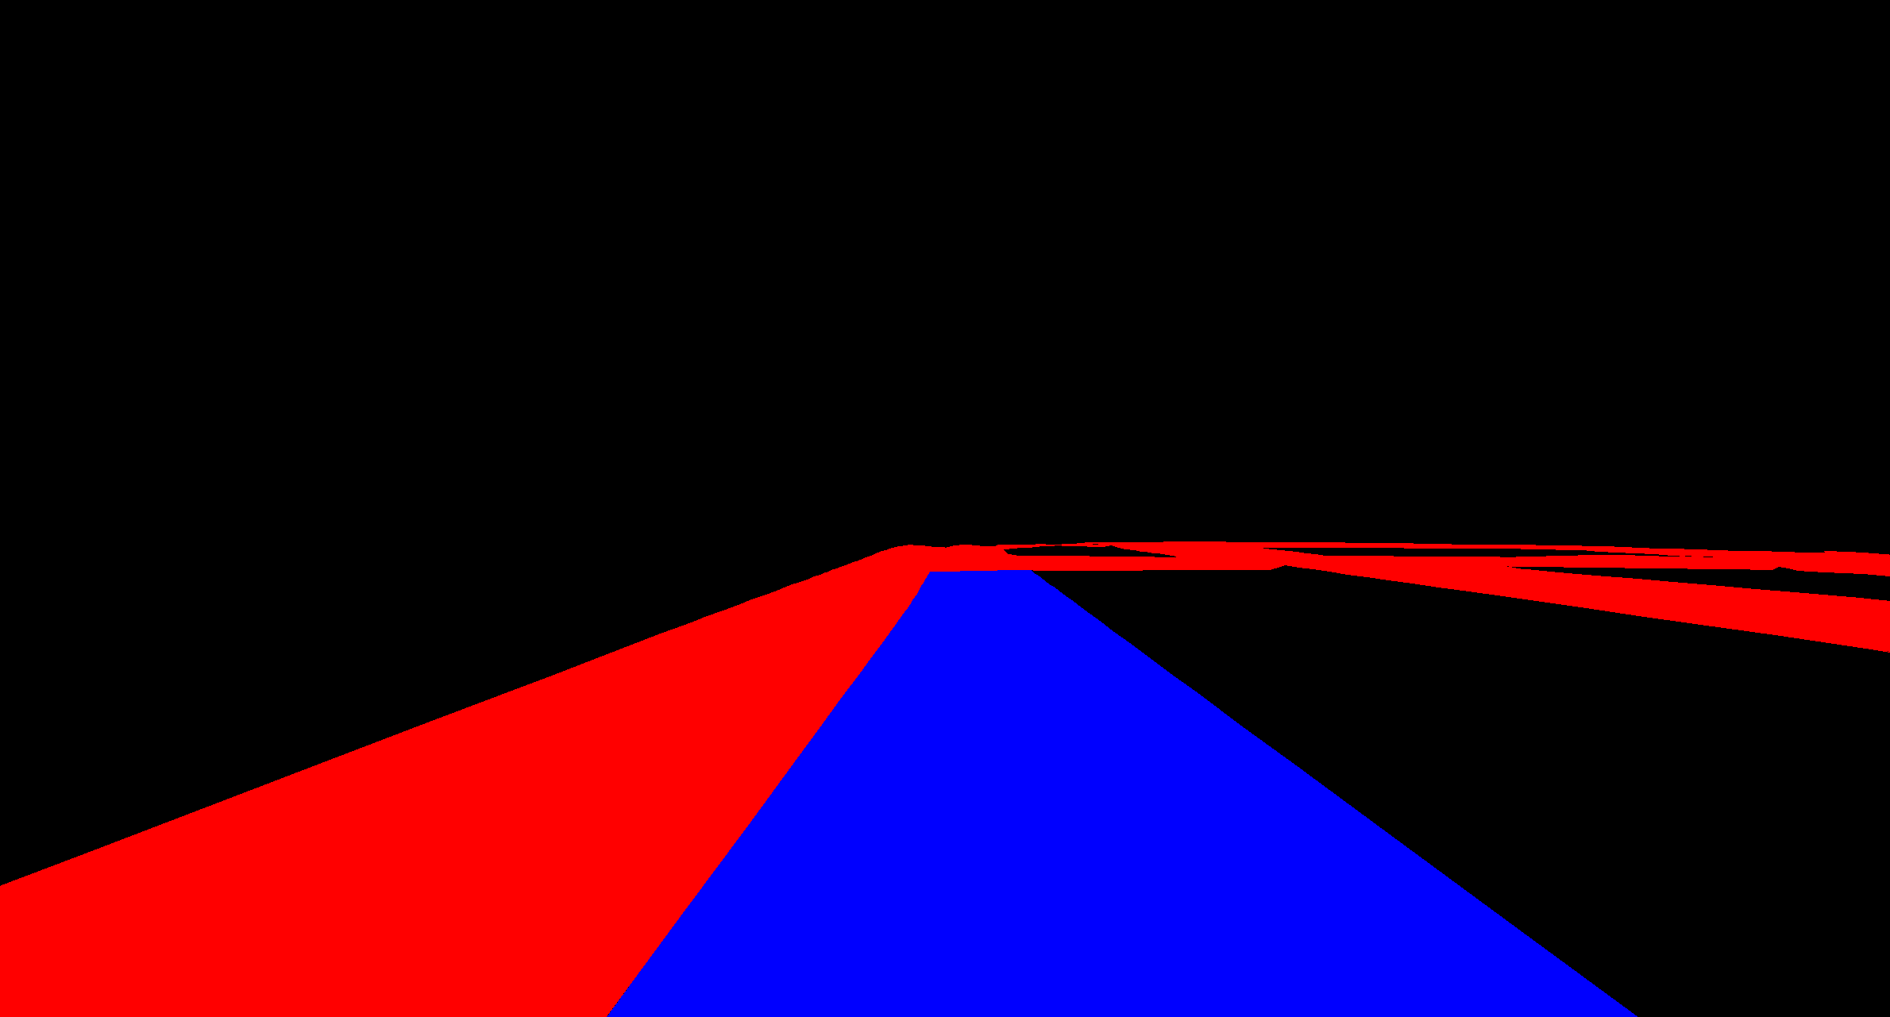
Semantic Road Segmentation for 1/8 Car
Eirik Fagerhaug, Novian Habibie
Project goals
Detect the road in input images using semantic segmentation
Scaled-down Deep Neural Network to fit in limited resources (race car model)
Create annotated ground truth of simulation track semi-automatically
FCN for Semantic Segmentation
Scaled-down FCN32
Compared to high-spec DNN : DeepLab, ResNet
Pre-experiment training using Cityscape dataset. Simplified segment classes : road and non-road
Environment Representation
Remote-controlled 1/8 car model (manual driving)
Input as sequence of images from Basler camera
Hand-assembled car track
Using motion capture system as position tracking
Semi-automatic dataset generation
Car track map as set of polygons, captured manually using marker wand. Interpolated to get smoother polygons. Refined by hand.
Record (undistorted) raw image from with calibrated camera and pose of car from MoCap system as ROS bagfile
Create label images by backproject seen polygons in camera field-of-view w.r.t pose of car to 2D images.
Provide two types of label image:
1. 1-class: only road (green) and non-road (black)
2. 3-class: current lane (blue), intersection(green), other lane(red)
Result
8698 set of data (raw image, 1-l, 3-label) from 6240.890 seconds of ROS bagfile
Live ground truth visualization (label image & seen polygons)
Fast road segmentation using scaled-down FCN32 (xx second per image)
High-spec DNNs have better results, but slower segmentation speed
Notes:
<number>

